Slide 8
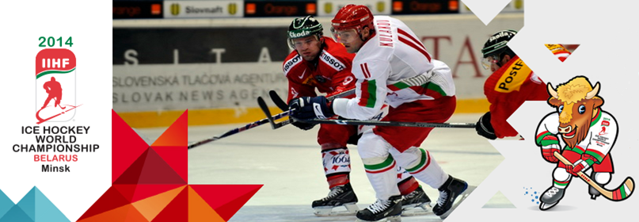
Group "А":
Sweden (№1 in IIHF World Ranking), Czech Republic (4), Canada (5), Slovakia (8), Norway (9), Denmark (12), France (13), Italy (18).
Group "В":
Finland (2), Russia(3), USA (6), Switzerland (7), Germany (10), Latvia (11), Belarus (14), Kazakhstan (16).

Slide 12
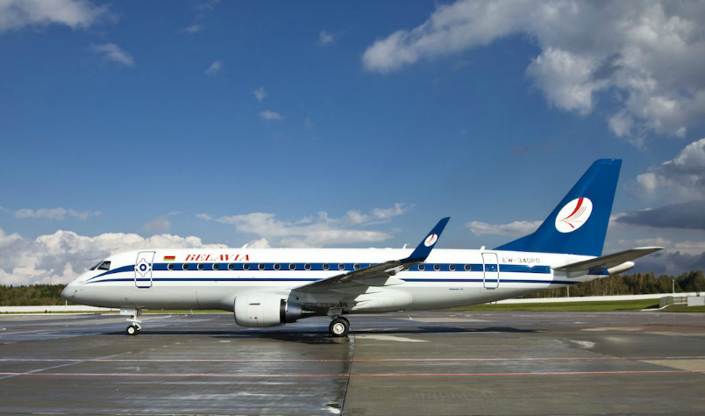

Slide 16
Team bus

Slide 18
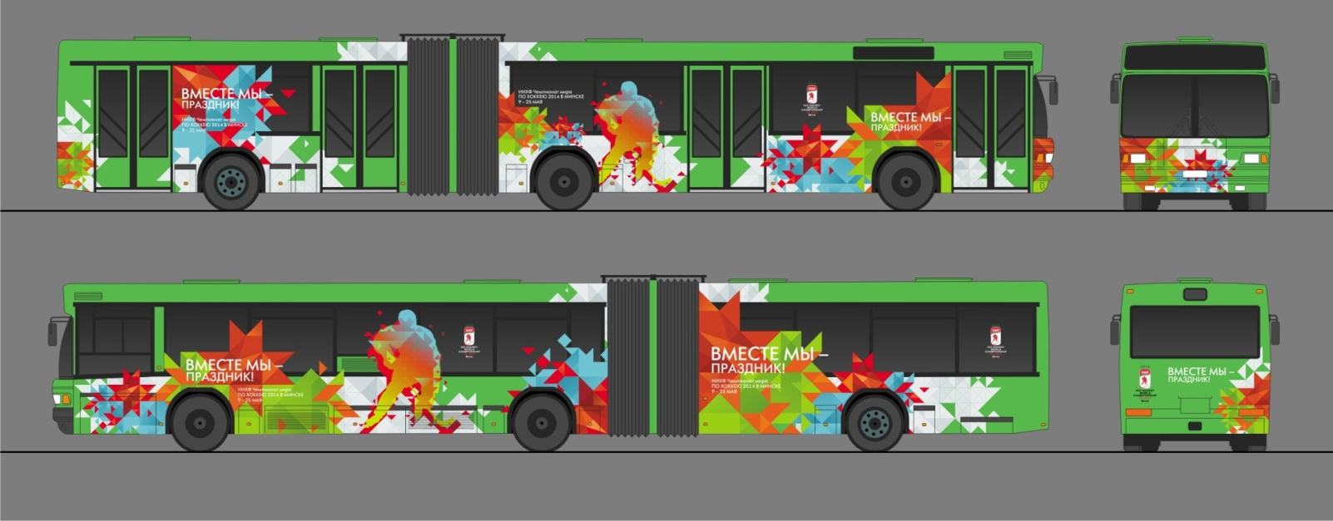
Free public transport in Minsk for the official participants and guests of the Championship

Slide 20
Fan Village complex

Slide 21
Fan Village complex

Slide 22
Victoria Hotel

Slide 23
Victoria-Olymp Hotel

Slide 24
Minsk Hotel

Slide 25
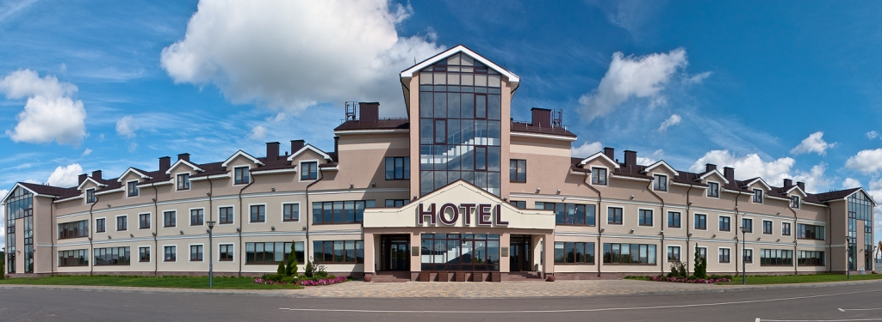
Robinson Club Hotel

Slide 26
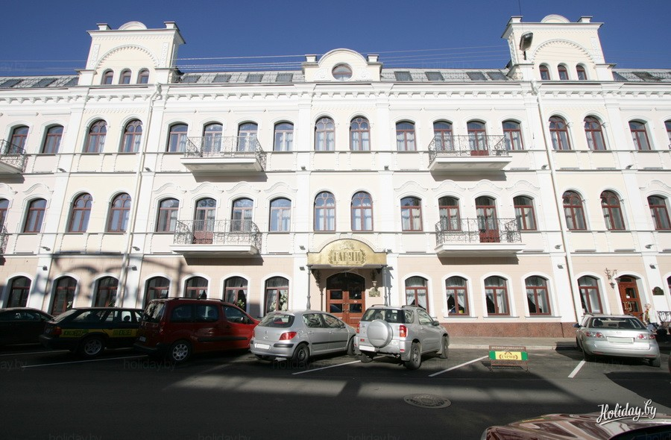
Garni Hotel

Slide 28
Europe Hotel

Slide 29
Crowne Plaza Hotel

Slide 30
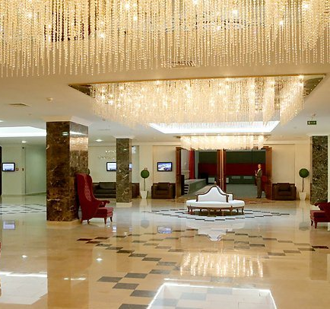

Slide 31
Accommodation rates in Minsk
≈ 7-8 € - Hostel
≈ 270 € - Standard Single Room in 5 * Hotel
The average price for a night in a hotel in Minsk
≈ 55 €

Slide 32
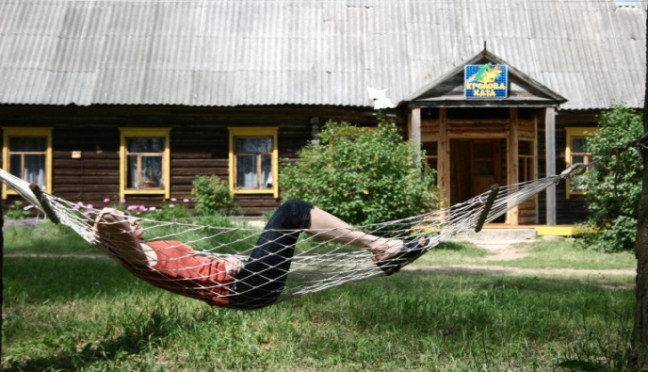
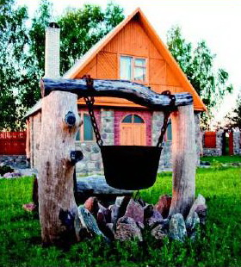
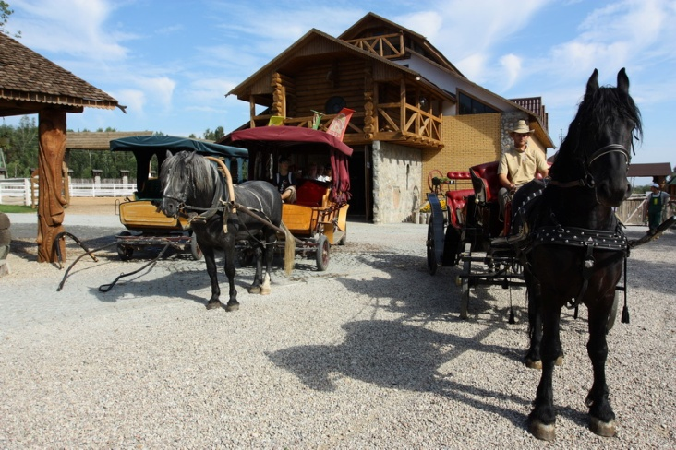
Country of Hospitable Villages
About 2,000 farmsteads, located in picturesque places with their hospitable hosts will help you to restore emotional balance and reinforce health.

Slide 34
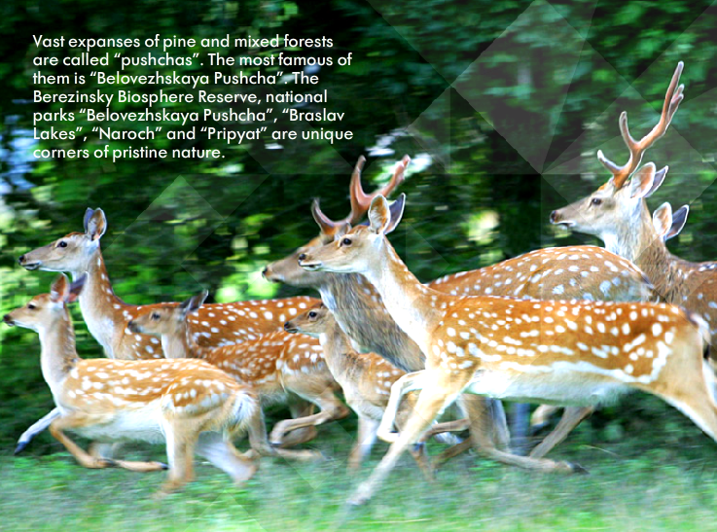

Slide 37
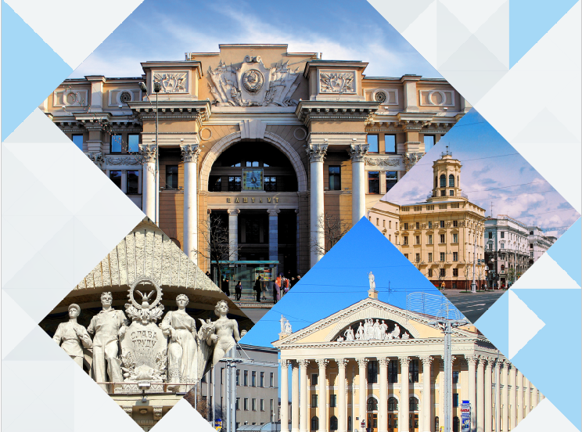

Slide 38
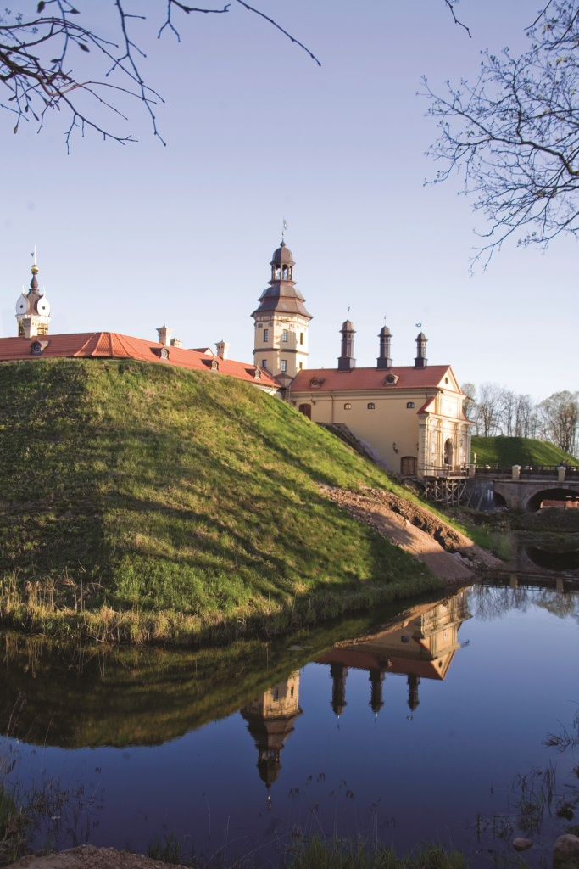
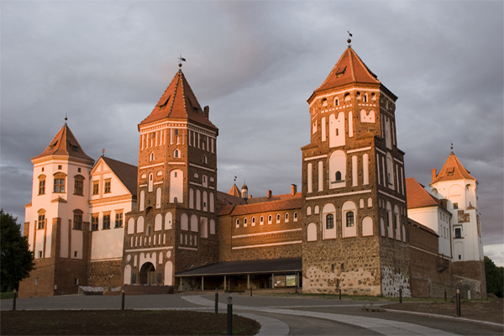
UNESCO Heritage

Slide 39
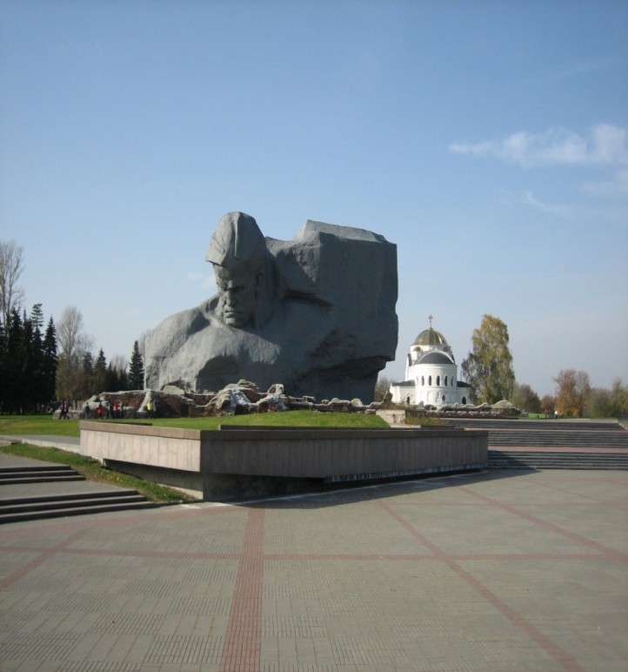
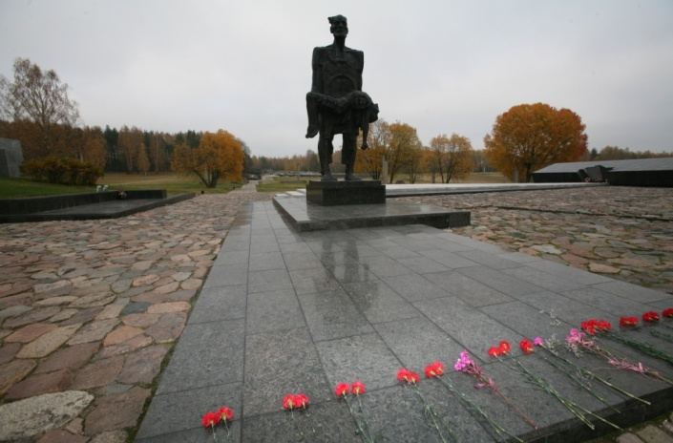
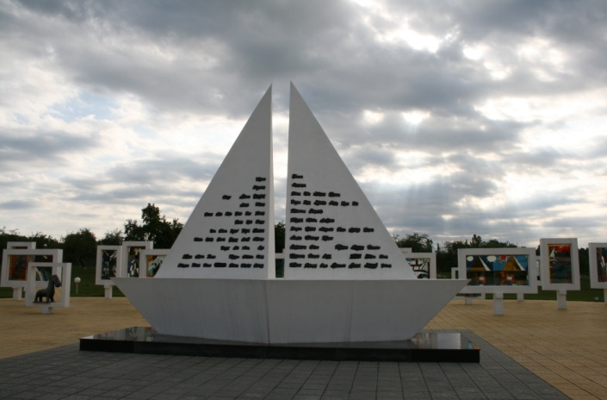
Brest Fortress, Memorial Complex "Khatyn", » Memorial Complex «Krasny Bereg» keep the memory of the events of the Great Patriotic War.
Silent Witnesses of History

Slide 41
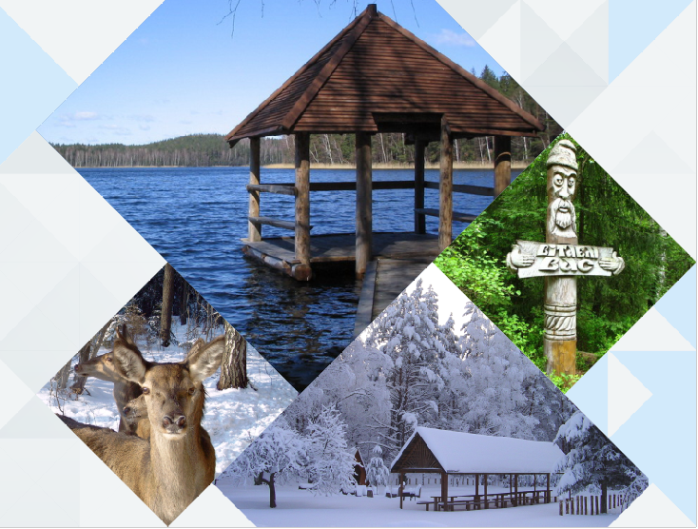

Slide 42
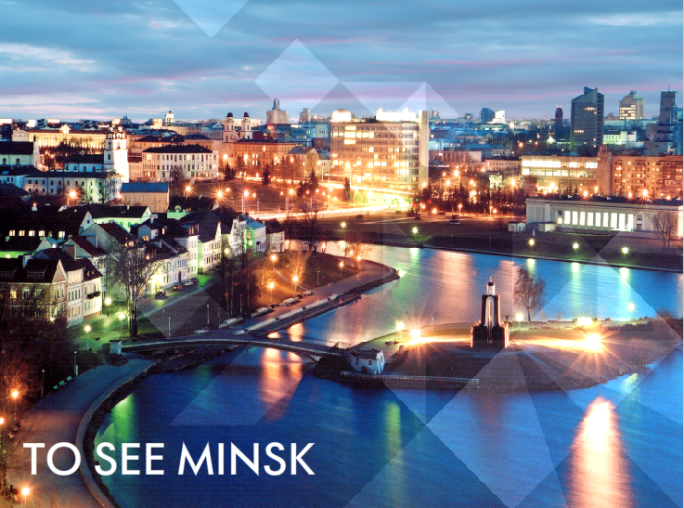

Slide 43
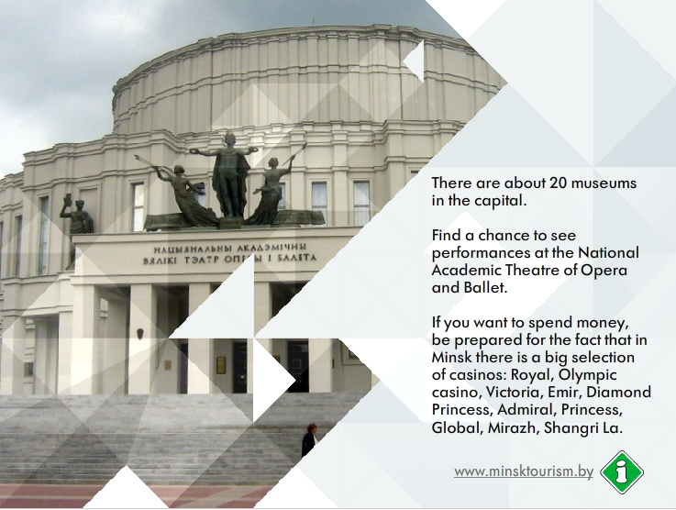

Slide 45
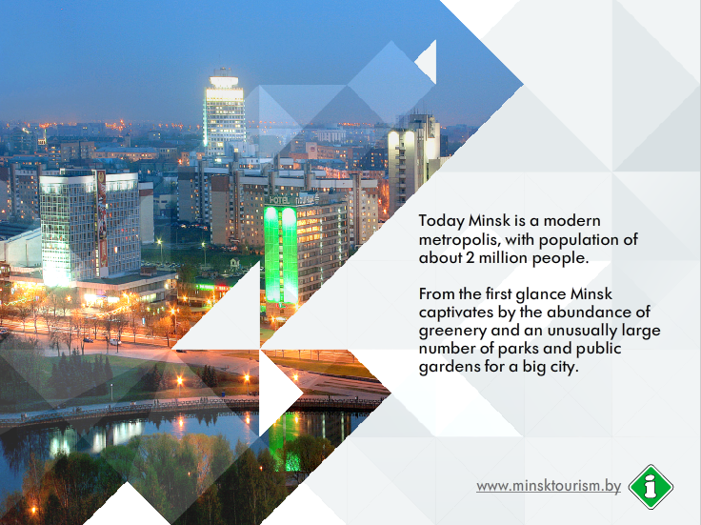

Slide 46
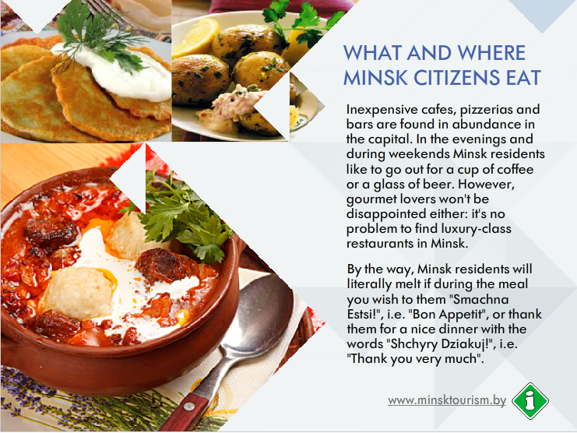

Slide 47
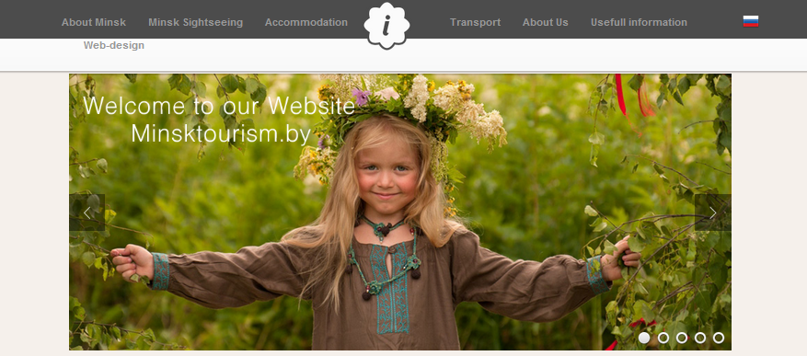
www.minsktourism.by
- Information Tourist Center «Minsk» website

Slide 48
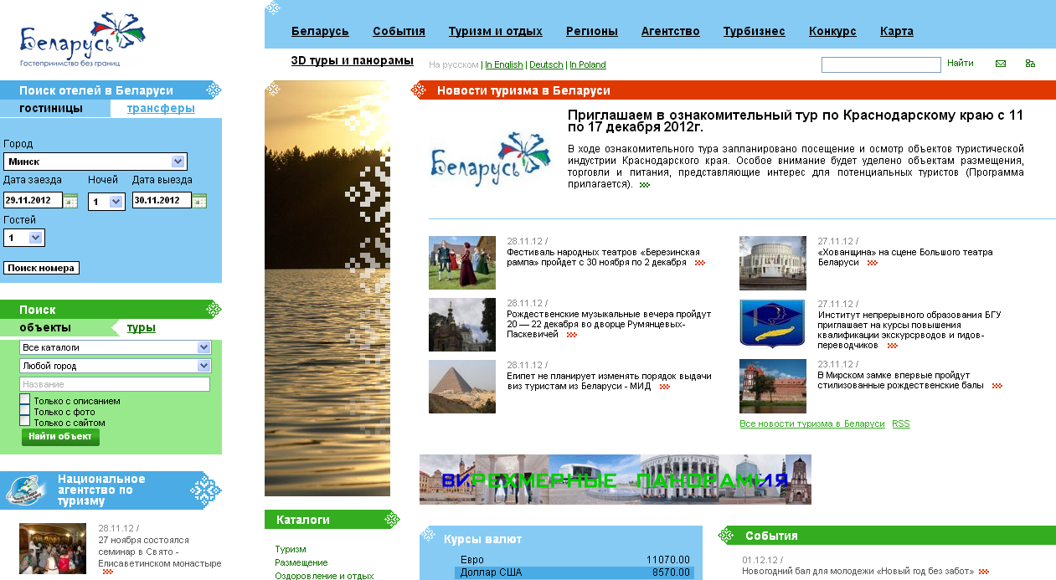
www.belarustourism.by
- specialized website about tourism and recreation in Belarus

Slide 52
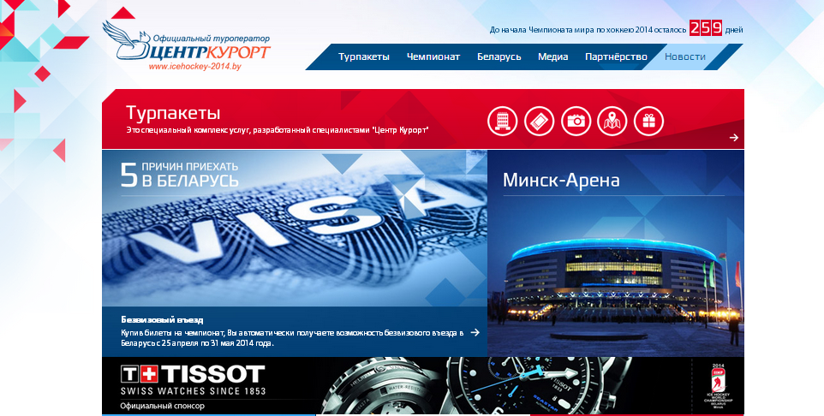
www.icehockey-2014.com
- CentreKurort website

Slide 53
International Ticket Operator TICKETPRO in Belarus

Slide 54
Ticket prices will vary from
10 euro (qualifying games) to
300 euro (semifinals and finals).

Slide 55
Ticket Sales Schedule
 | 09 | 10 | 11 | 12 | 01 | 02 | 03 | 04 | 05
 | 2013 |  |  |  | 2014
Event Tickets | 01.09.2013 - 01.05.2014
Group Round Tickets |  | 01.10.2013 - 01.05.2014
Day Tickets BY* |  |  | 01.10.2013 - 01.05.2014
Final Round Tickets |  | 01.11.2013 - the 12th day of the tournament
Final Game Tickets |  |  |  | 01.12.2013 - the 17th day of the tournament
Day Tickets |  |  |  |  | 01.01.2014 - the 17th day of the tournament
Single Game Tickets |  |  |  |  |  | 01.02.2014 - the 17th day of the tournament

Slide 57
www.minsk2014.com

